Slide 1
GRSE ACCELERATED INNOVATION NURTURING SCHEME (GAINS)
BRIEFING – 10 Jul 24

Slide 2
Contents
Background
Open Innovation & GAINS
Structure for GAINS
Thematic Areas
GAINS Implementation Process
Reward & Revenue Sharing
Success Story of The Inaugural Edition Of GAINS, GAINS-2023
Implementation Timelines

Slide 3
Background
In-house efforts has only paid incremental dividends due limited exposure of yard personnel to:-
Emerging technologies
Start-up environment as a whole
Need to provide shipyard with wide access to innovators, making a broad range of talents visible
Leverage thriving Start-up ecosystem in India for breakthrough solutions
Facilitate fostering culture of innovation, competitiveness and high level of efficiency

Slide 4
Open Innovation & GAINS
An effective way to gather ideas from outside the organisation to create better (and cheaper) solutions in relative short time
Attracts more talent with a wider pool of ideas drawn from a broader experiential base, contributing to innovative cross fertilisation
GAINS - an “Open Challenge” scheme launched on 22 May 23

Slide 5
Structure for GAINS
GAINS Challenge will be a two-stage process
Generation of large number of ideas expected from which a few promising ones may be selected and nurtured
Proposals will be invited from eligible individuals/ entities to provide innovative technological & business solutions in selected thematic areas

Slide 6
Structure for GAINS
GAINS Challenge to be conducted by the GAINS team :-
CGM(Innovation) - GAINS Challenge Leader
Members from Design, Production, IT and CC and IND
Selection of Start-ups in Stage-I and Stage-II will be undertaken by a GAINS Evaluation Committee
Negotiation and Placement of Order Through Apex Committee

Slide 7
Thematic Areas
Artificial Intelligence in shipbuilding (AI)
Renewable/ Green Energy and Energy Efficiency
Efficiency Enhancement in shipyard

Slide 8
GAINS Implementation Process
ANNOUNCE CHALLENGE
INITIATION / FAMILIARISATION
SHORT & ILLUSTRATED
ORDER OF COST
PROF QUALIFICATION
STAGE – I - SUBMISSION
ELIGIBILITY
COST & TIME
IMPLEMENTABILITY
VALUE TO BUSINESS
STAGE – I
4-5 SELECTED BY COMMITTEE
STAGE – II – SUBMISSION
(PROJECT REPORT)

Slide 9
GAINS Implementation Process
DETAILED PROPOSAL
IMPL. STRATEGY
TIMELINES & COSTING
ESTIMATE OF ROI
STAGE – II – SUBMISSION
(PROJECT REPORT)
PAYMENT OF UPTO RS 5 LAKHS AGAINST PROJECT REPORT
EVALUATION BY COMMITTEE
INTERVIEWS/PRESENTATION
MANDAYS/ MATERIAL ETC.
RECOMMENDATION OF COMMITTEE
COMMERCIAL VIABILITY
(MARKET SURVEY, PUBLICATIONS ETC.)
COMMERCIAL TERMS
IPR
NEOGOTION BY APEX COMMITTEE & AWARD OF CONTRTACT
DELIVERY

Slide 10
Intellectual Property Rights
Start-ups to confirm ownership of IPRs subsisting in their proposals and no infringement on any third party's IPRs
The Start-ups will obtain all permissions from third parties to use their IPRs for any application required for the proposal
GRSE will not retain any ownership of the idea/ proposal submitted by the participating Start-ups
IPR of the commercially viable final product post placement of order will be jointly (and equally) held by GRSE and the Start-up

Slide 11
Reward and Revenue Sharing
Payment envisaged against Stage-II deliverables (up to Rs 5 Lakhs)
Winner(s) may be awarded contract(s)
If the product is sold to other customers, a revenue sharing model will be worked out. This will be approved by Apex Committee

Slide 12
Success Story of The Inaugural Edition Of GAINS, GAINS-2023
Launched by the then Honorable Minister of state for skill development, entrepreneurship, electronics & IT, Shri Rajeev Chandrashekar Ji on 22 May 23
Received an overwhelming response from innovators all across the country
06 promising proposals were selected for detailed evaluation in Stage II and paid incentives of up to Rs 4 Lakhs each for their efforts.
M/s Smart Machines and Structures (MSME) and M/s Bodkin Technologies Pvt Ltd (Start-up) were declared winners of GAINS 2023 on 29 Sep 23 and Contract Awarded by GRSE on 26 Mar 2024.

Slide 13
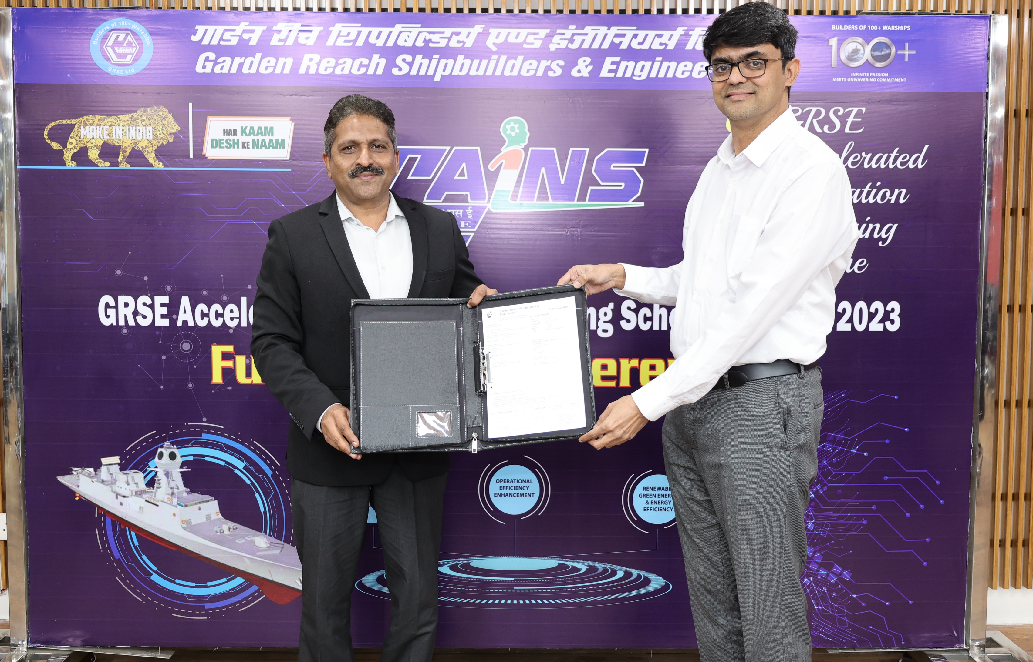
Success Story of The Inaugural Edition Of GAINS, GAINS-2023
M/s Smart Machines and Structures (MSME)

Slide 14
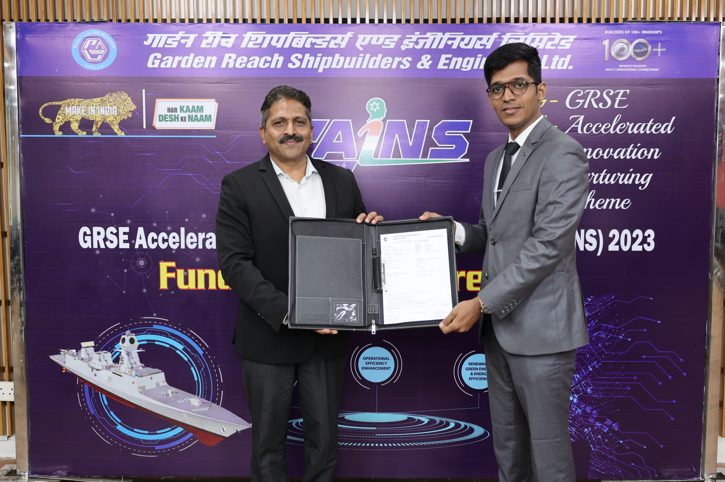
Success Story of The Inaugural Edition Of GAINS, GAINS-2023
M/s Bodkin Technologies Pvt Ltd (Start-up)

Slide 15
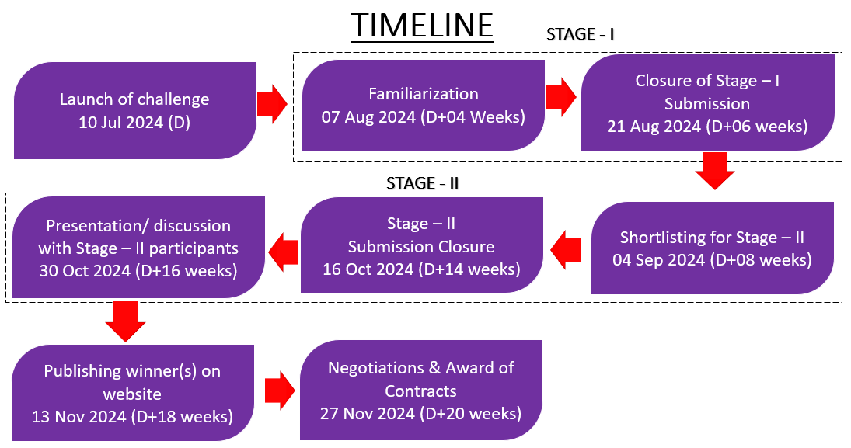
Timeline for Implementation

Slide 16
JAI HIND

